Slide 1
CSE495B (Natural Language Processing) Lecture 3
NLP Pipeline & Tokenization (Features for NLP)

Slide 2
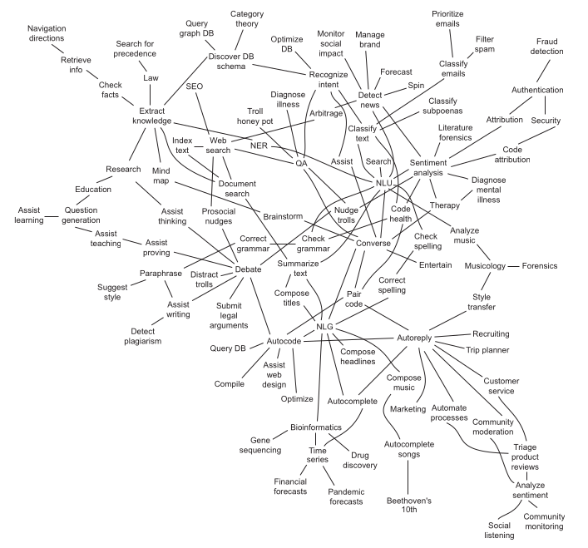
NLP Applications

Slide 3
NLP Applications
At the heart of NLP lie two complementary components: Natural Language Understanding (NLU) and Natural Language Generation (NLG).
NLU underpins foundational applications such as sentiment analysis, intent detection, and semantic search, enabling machines to interpret and reason over human language.
NLG, in turn, powers systems like spelling correctors, grammar checkers, automatic summarizers, and even advanced tools such as code generators or pair-programming assistants.
Together, NLU and NLG form the backbone of conversational AI.
A search engine, for instance, can deliver more meaningful results when it indexes web pages or document archives based on the underlying meaning of natural language text rather than keywords alone (NLU).
Similarly, auto-complete—now standard in search engines and smartphone keyboards—relies on NLP to predict and complete user input in real time (NLG).

Slide 4
NLP Applications
Many word processors and text editors now embed NLP-powered features.
These range from basic spelling and grammar correction (using NLU to detect errors) to more advanced functions such as concordance generation, style guidance, and real-time writing suggestions (leveraging NLG to propose improved phrasing).
Recent advances extend these tools even further.
AI-assisted paraphrasing and summarization can help writers quickly reframe their ideas or condense long passages.
Predictive academic writing assistants can recommend citations, suggest topic-specific vocabulary, or generate coherent drafts based on outlines.
These two tools illustrate how NLU and NLG are evolving from simple editing aids to intelligent collaborators in creative and scholarly work.
Modern dialogue systems (chatbots) extend these capabilities by leveraging natural language search to retrieve and formulate contextually relevant responses for ongoing conversations.
Machine translation (Google Translate, DeepL) combines NLU to grasp the meaning of the source language and NLG to fluently render it in the target language.
This enables real-time multilingual communication across diverse platforms.

Slide 5
NLP Pipeline
In Natural Language Processing (NLP), a pipeline refers to a structured sequence of steps that progressively transform raw text into meaningful outputs for analysis or real-world applications.
It works much like a factory assembly line—each stage transforms the data, preparing it for the next until the final output is ready.
Typical stages of an NLP pipeline include:
Data Acquisition – Collecting raw textual data from sources such as documents, social media, or speech transcripts.
Text Preprocessing – Cleaning and normalizing text (e.g., tokenization, stopword removal, lemmatization).
Feature Engineering – Representing text in a machine-readable form, such as word embeddings or vector encodings.
Modeling – Applying statistical or machine learning models to perform tasks like classification, translation, or summarization.
Evaluation – Assessing model performance using metrics such as accuracy, F1-score, or BLEU.
Deployment – Integrating the trained model into applications, such as chatbots, search engines, or recommendation systems.

Slide 6
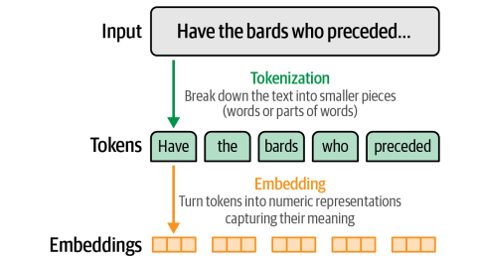
Tokenization

Slide 7
Tokenization
Tokenization is a kind of text document segmentation.
To break down larger pieces of text chunks into smaller meaningful ones
The set of valid tokens for a particular language is called the vocabulary for that language, or, more formally, its lexicon.
Linguistics and NLP researchers use the term lexicon to refer to a set of natural language tokens.
The term vocabulary is the more natural way to refer to a set of natural language words or tokens
To build up a vocabulary, the first thing to do is to break the documents or sentences into chunks called tokens
Each token carries a semantic meaning associated with it
Tokenization is one of the fundamental things to do in any text-processing activity
Tokens generally comprise words and numbers, but they can be extended to include punctuation marks, symbols, and, at times, understandable emoticons

Slide 8
Tokens in NLP are Features
Tokens are the features for ML of NLP
NLP models cannot take raw strings as inputs
These are machine learning models
They assume the text has been tokenized and encoded as numerical vectors
There are several tokenization strategies, and the optimal splitting of words into sub-units is usually learned from the corpus
Broadly, there are three kinds of tokenization
Character level tokenization
Word level tokenization
Sub-word level tokenization

Slide 9
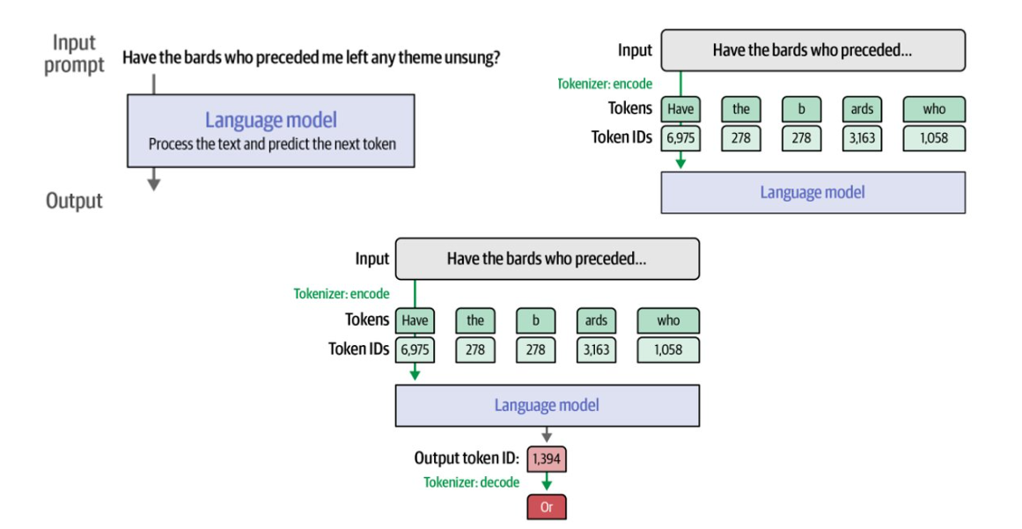
How do we use tokenization?

Slide 10
Space-based tokenization
A very simple way to tokenize
For languages that use space characters between words
Arabic, Cyrillic, Greek, Latin, etc., based writing systems
Segment off a token between instances of spaces
Unix tools for space/punctuation-based tokenization
The "tr" command
Inspired by Ken Church's UNIX for Poets
Given a text file, output the word tokens and their frequencies

Slide 11
Space-based Tokenization
The simplest tokenization is to use space as a separator
sentence = "The capital of Bangladesh is Dhaka"
sentence.split()
Here's the output.
['The', 'capital', 'of', ‘Bangladesh', 'is', ‘Dhaka’]
A sentence.split() provides all the different tokens in a sentence
Is it adequate?
Each token in the preceding split carries an intrinsic meaning; however, it is not always as straightforward as this

Slide 12
Simple Tokenization issues
Consider the sentence and corresponding split in the following example:
sentence = "China's capital is Beijing"
Apply sentence.split()
Here's the output:
["China's", 'capital', 'is', 'Beijing’]
In the preceding example, should it be China, Chinas, or China’s?
A split method does not often know how to deal with situations containing apostrophes and special symbols

Slide 13
More Issues for Space-based Tokenization
Can't just blindly remove punctuation:
m.p.h., Ph.D., AT&T, cap’n
prices ($45.55)
dates (01/02/06)
URLs (http://www.stanford.edu)
hashtags (#nlproc)
email addresses (someone@cs.colorado.edu)
Clitic: a word that doesn't stand on its own
"are" in we're
When should multiword expressions (MWE) be words?
New York, rock ’n’ roll

Slide 14
Different types of word tokenizers
There are different kind of tokenizers
Rule based
Regular expressions-based tokenizers
Treebank tokenizers
Tweet tokenizers
Character based
Word based
Sub-Word based

Slide 15
Regular expression-based tokenizers
Regular expressions are sequences of characters that define a search pattern
They are one of the earliest and are still one of the most effective tools for identifying patterns in text
It can be used to tokenize or split a sentence based on a provided regular expression
Take the following sentence:
A Rolex watch costs in the range of $30000 - $500000 in the USA.
Here, we would like to have expressions indicating money, alphabetic sequences, and abbreviations together

Slide 16
Treebank tokenizer
The Treebank tokenizer also uses regular expressions to tokenize text according to the Penn Treebank (https:/​/​catalog.​ldc.​upenn.​edu/​docs/​LDC95T7/​cl93.​html)
Here, words are mostly split based on punctuation.
The Treebank tokenizer does a great job of splitting contractions such as doesn't to does and n’t
It further identifies periods at the ends of lines and eliminates them
Punctuation such as commas is split if followed by whitespaces

Slide 17
Tweet Tokenizer
The rise of social media has given rise to an informal language where people tag each other using their social media handles and use a lot of emoticons, hashtags, and abbreviated text to express themselves
We need tokenizers in place that can parse such text and make things more understandable.
TweetTokenizer caters to this use case significantly

Slide 18
Character level Tokenization
The most straightforward tokenization scheme is to feed the characters individually to the NLP models
The tokens for the string "Character level" will have these tokens: ['c', 'h', 'a', 'r', 't', 'e', 'l', 'v']
Character level tokenization ignores any structure in the text and treats the whole string as a stream of characters
It can deal with misspellings and rare words
But the linguistic structures such as words need to be learned from the data
This requires significant compute, memory, and data

Slide 19
Full Word Tokenization
Word tokenization splits sentences into words
Whole words preserve the semantics of the languages
Reduces the complexity of the training process
One simple class of word tokenizers uses whitespace to tokenize the text
For example, the string "Tokenizing text is a core task of NLP" will have tokens: ['Tokenizing', 'text', 'is', 'a', 'core', 'task', 'of', 'NLP.']
Sometimes punctuation is not accounted for, so “NLP.” is treated as a single token and different than “NLP”
Given that words can include conjugations, misspellings, etc., the size of the vocabulary can easily grow into the millions!
Stemming, lemmatization, spell-correction can reduce the size of vocabulary – traditional nlp mostly

Slide 20
Sub Word Tokenization
Breaking text into words may feel natural as words have semantic meanings in any language
However, words that are not included in the vocabulary are treated by NLP algortihms as “unknown”
Subword tokenization address this issue by combining the best aspects of character and full word tokenization
By tokenizing text into subword units, which often retain linguistic meaning (e.g., morphemes)
Even though a word may be unknown to the model, individual subword tokens may retain enough information for the model to infer the meaning to some extent
We want to split rare words into smaller units to allow the model to deal with complex words and misspellings
And we want to keep frequent words as unique entities so that we can keep the length of our inputs to a manageable size
The main distinguishing feature of subword tokenization is that it is learned from the training corpus using a mix of statistical rules and algorithms

Slide 21
Subword Tokenizer: BPE
Byte-Pair Encoding (BPE) was initially developed for text compression, and then used by OpenAI for tokenization for the GPT model
It’s used by a lot of Transformer models, including GPT, GPT-2, RoBERTa, BART, and DeBERTa
Subword Tokenization:
BPE as a subword tokenization algorithm doesn’t tokenize text into words
But into subword units
It starts with a vocabulary where each character in the original text is initially treated as a token
Then use something like huffman encoding

Slide 22
BPE Algorithm
Merging Most Frequent Pairs:
Iteratively merges the most frequent pairs of consecutive tokens
The most frequent pair is merged to a new token
This process is repeated until a specified vocabulary size is reached
Handling Out-of-Vocabulary Words:
Effective in handling out-of-vocabulary words
Because it can represent any word by a sequence of subword tokens
Rare words or words not present in the training data can be represented using subword units that are part of the vocabulary
Variable-Length Representations:
BPE naturally handles variable-length representations of words
Very useful for NLP where length of text is different for the input data

Slide 23
BPE Algorithm
Words = ["hug", "pug", "pun", "bun", "hugs"]
Initial Vocabulary: ["b", "g", "h", "n", "p", "s", "u"]
After getting this base vocabulary, the algorithm adds new tokens until the desired vocabulary size is reached
At the beginning these merges will create tokens with two characters, and then, as training progresses, longer subwords
At any step during the tokenizer training, the BPE algorithm will search for the most frequent pair of existing tokens (by “pair,” here we mean two consecutive tokens in a word).
That most frequent pair is the one that will be merged, and we rinse and repeat for the next step

Slide 24
BPE Algorithm (How)
For example, we have a corpus with: ("hug", 10), ("pug", 5), ("pun", 12), ("bun", 4), ("hugs", 5)
Initial Vocabulary: ["b", "g", "h", "n", "p", "s", "u"]
The pair ("h", "u") is present in the words "hug" and "hugs", so 15 times total in the corpus.
It’s not the most frequent pair, though: that belongs to ("u", "g"), which is present in "hug", "pug", and "hugs", for a grand total of 20 times in the vocabulary.
The new set of vocabulary will be like:
Vocabulary: ["b", "g", "h", "n", "p", "s", "u", "ug"]
Corpus: ("h" "ug", 10), ("p" "ug", 5), ("p" "u" "n", 12), ("b" "u" "n", 4), ("h" "ug" "s", 5)

Slide 25
BPE
Now we have some pairs that result in a token longer than two characters: the pair ("h", "ug"), for instance (present 15 times in the corpus).
The most frequent pair at this stage is ("u", "n"), however, present 16 times in the corpus, so the second merge rule learned is ("u", "n") -> "un". Adding that to the vocabulary and merging all existing occurrences leads us to:
Vocabulary: ["b", "g", "h", "n", "p", "s", "u", "ug", "un"]
Corpus: ("h" "ug", 10), ("p" "ug", 5), ("p" "un", 12), ("b" "un", 4), ("h" "ug" "s", 5)

Slide 26
BPE
Now the most frequent pair is ("h", "ug"), so we learn the merge rule ("h", "ug") -> "hug", which gives us our first three-letter token. After the merge, the corpus looks like this:
Vocabulary: ["b", "g", "h", "n", "p", "s", "u", "ug", "un", "hug"]
Corpus: ("hug", 10), ("p" "ug", 5), ("p" "un", 12), ("b" "un", 4), ("hug" "s", 5)

Slide 27
BPE token learner
Merge e r to er

Slide 28
BPE
Merge er _ to er_

Slide 29
BPE
Merge n e to ne

Slide 30
BPE
The next merges are:

Slide 31
BPE Conclusion
It's reversible and lossless, so it is possible to convert tokens back into the original text
It works on arbitrary text, even text that is not in the tokenizer's training data
It compresses the text: the token sequence is shorter than the bytes corresponding to the original text
On average, each token corresponds to about 4 bytes
It attempts to let the model see common subwords
For instance, "ing" is a common subword in English, so BPE encodings will often split "encoding" into tokens like "encod" and "ing" (instead of e.g. "enc" and "oding")
Because the model will then see the "ing" token again and again in different contexts, it helps models generalize and better understand grammar

Slide 32
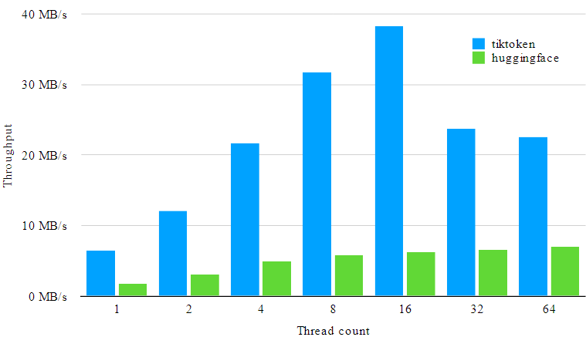
Latest BPE: tiktoken
GitHub - openai/tiktoken: tiktoken is a fast BPE tokeniser for use with OpenAI's models.
Interesting read: https://simonwillison.net/2023/Jun/8/gpt-tokenizers/

Slide 33
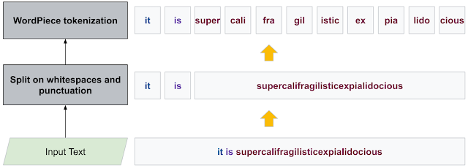
Subword Tokenizer: WordPiece
WordPiece is the tokenization algorithm Google developed to pretrain BERT
Also used by DistilBERT, MobileBERT, Funnel Transformers, MPNET, etc.
Notes:
Original wordpiece: 1609.08144.pdf (arxiv.org)
Improved one 2012.15524.pdf (arxiv.org)
Helpful: 1508.07909.pdf (arxiv.org)

Slide 34
Wordpiece Tokenization
Wordpiece identifies subwords by adding a prefix (like ## for BERT), each word is initially split by adding that prefix to all the characters inside the word
So, for instance, "word" could split to: [w, ##o, ##r, ##d]
Similar to BPE, WordPiece learns merging rules (from the corpus)
The main difference is the way the pair to be merged is selected
Instead of selecting the most frequent pair, WordPiece computes a score for each pair using the following formula:
Score=(freq_of_pair)/(freq_of_first_element×freq_of_second_element)

Slide 35
Wordpiece Tokenization
Score=(freq_of_pair)/(freq_of_first_element×freq_of_second_element)
By dividing the frequency of the pair by the product of the frequencies of each of its parts, the algorithm prioritizes the merging of pairs where the individual parts are less frequent in the vocabulary
For instance, it won’t necessarily merge ("un", "##able") even if that pair occurs very frequently in the vocabulary, because the two pairs "un" and "##able" will likely each appear in a lot of other words and have a high frequency.
In contrast, a pair like ("hu", "##gging") will probably be merged faster (assuming the word “hugging” appears often in the vocabulary) since "hu" and "##gging" are likely to be less frequent individually.

Slide 36
Unigram: Regularizing Tokens
The Unigram LM tokenizer utilizes statistical language modeling techniques to estimate the likelihood of different phrases and determine the optimal vocabulary size for tokenization
It starts from an extensive vocabulary and removes tokens until the size of the vocabulary reaches the limit (a regularization method)
Initial vocabulary may come from BPE
Alternatively, we can take the most common substrings in pre-tokenized words
At each step, it prunes the vocabulary
Uses negative log likelihood (like a language model)
For each token, it computes how much the overall loss would increase if the token is discarded
Finds the set of tokens that would increase the loss the least
These tokens have a lower contribution on the overall loss, so they are “less needed” and are the best candidates for the removal
The pruning of tokens is done on a bunch, not individual basis (to make the process efficient)
Some tokens are not removed at all
They are base tokens and discarding them may make the corpus non-tokenizable
Notes:
Interesting paper on this topic: 2004.03720.pdf (arxiv.org)

Slide 37
Calculating Unigram Probability
Suppose we have this corpus: ("hug", 10), ("pug", 5), ("pun", 12), ("bun", 4), ("hugs", 5)
And, we use this base vocabulary: ["h", "u", "g", "hu", "ug", "p", "pu", "n", "un", "b", "bu", "s", "hug", "gs", "ugs"]
Unigram regularization uses probability to find the loss
The probability is calculated from its frequency in the current vocabulary divided by the sum of all frequencies of all tokens in the vocabulary
If "ug" is present 20 times in our corpus, which contains 210 tokens in total, “ug” will have a probability of 20/210
We are considering only the frequency of the interested token (“ug” in this case) without any dependency
That is why this scheme is called unigram

Slide 38
Calculating Unigram Probability
Suppose we have this vocabulary: ("h", 15) ("u", 36) ("g", 20) ("hu", 15) ("ug", 20) ("p", 17) ("pu", 17) ("n", 16) ("un", 16) ("b", 4) ("bu", 4) ("s", 5) ("hug", 15) ("gs", 5) ("ugs", 5)
Suppose we want to tokenize the word “pug” and considering two schemes
Option 1: [“p”,”u”,”g”]
Option 2: [“pu”,”g”]
Option 1 has this probability for our corpus:
P([‘p’,’u’,’g’])=P(‘p’)×P(‘u’)×P(‘g’)= 17/210 × 36/210 × 20/210 = 0.0013216
Option 2 has this probability w.r.t. our corpus:
P([‘pu’,’g’])=P(‘pu’)×P(‘g’) = 17/210 × 20/210 = 0.007709
In general, tokenization with fewer tokens will have a higher probability

Slide 39
Calculating Unigram Probability
The tokenization of a word with the Unigram model is basically the tokenization with the highest probability
In the example of "pug", here are the probabilities we would get for each possible segmentation
["p", "u", "g"] : 0.0013216
["p", "ug"] : 0.007709
["pu", "g"] : 0.007709
So, "pug" would be tokenized as ["p", "ug"] or ["pu", "g"], depending on which of those segmentations is encountered first

Slide 40
From probability to Loss
Each token has a probability score and the loss is the negative log of that probability
Suppose we have this corpus: ("hug", 10), ("pug", 5), ("pun", 12), ("bun", 4), ("hugs", 5)
And current probability scores are:
"hug": ["hug"] (score 0.071428)
"pug": ["pu", "g"] (score 0.007710)
"pun": ["pu", "n"] (score 0.006168)
"bun": ["bu", "n"] (score 0.001451)
"hugs": ["hug", "s"] (score 0.001701)

Slide 41
From probability to Loss
For the tokenization scheme of the previous slide
Loss¹ = 10 * (-log(0.071428)) + 5 * (-log(0.007710)) + 12 * (-log(0.006168)) + 4 * (-log(0.001451)) + 5 * (-log(0.001701)) = 169.8
Now if we remove “hug” from the vocabulary, we get the following tokens
"hug": ["hug"] (score 0.071428)
"hug": ["hu", "g"] (score 0.006802)
"pug": ["pu", "g"] (score 0.007710)
"pun": ["pu", "n"] (score 0.006168)
"bun": ["bu", "n"] (score 0.001451)
"hugs": ["hu", "g", "s"] (score 0.001701)
The loss will increase by
Loss = Loss¹ + -10 * (-log(0.0071428)) + 10 * (-log(0.006802)) = 169.8 + 23.5

Slide 42
Unigram Conclusion
The Unigram Language Model subword tokenization algorithm offers efficient and accurate tokenization.
The training strategy involves reducing the vocabulary size while maintaining language modeling integrity.
The Unigram LM model assumes independence among tokens, enabling probability estimation and tokenization.
Estimating token probabilities and calculating loss aid in evaluating tokenization effectiveness.
The Viterbi algorithm enhances the speed and efficiency of word tokenization in the Unigram model.

Slide 43
Sentencepiece Tokenizer
Not all languages use spaces to separate words. One possible solution is to use language-specific pre-tokenizers, e.g., XLM uses a specific Chinese, Japanese, and Thai pre-tokenizer).
To solve this problem more generally, SentencePiece: A simple and language independent subword tokenizer and detokenizer for Neural Text Processing (Kudo et al., 2018) treats the input as a raw input stream, thus including the space in the set of characters to use.
Then, use the BPE or unigram algorithm to construct the appropriate vocabulary.
Notes:
1808.06226.pdf (arxiv.org)

Slide 44
Sentencepiece Tokenizer
SentencePiece is an unsupervised text tokenizer and de-tokenizer mainly for Neural Network-based text generation systems where the vocabulary size is predetermined before the neural model training
It acts as a framework
SentencePiece implements subword units (e.g., BPE and unigram language model) with the extension of direct training from raw sentences
SentencePiece allows us to make a purely end-to-end system without language-specific pre/postprocessing

Slide 45
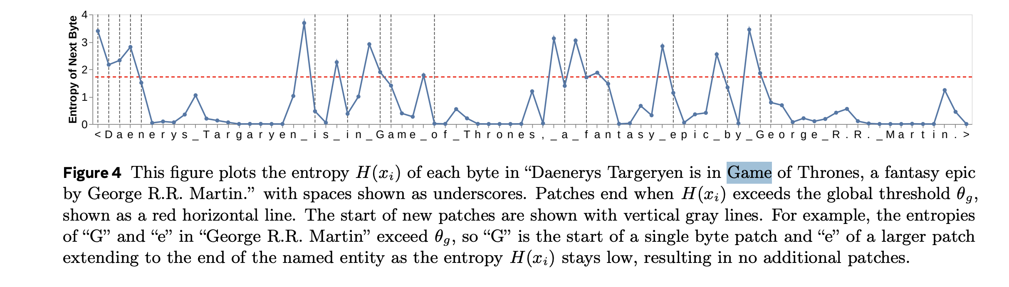
BLT (Byte Latent Transformer) Patches compared to Tokens

Slide 46
Special Tokens
Depending on the model, a few special tokens are added to the vocabulary to facilitate processing. These tokens can include:
<PAD> To indicate padding, in case the size of the input is less than the maximum sequence length.
<EOS> To indicate the end of the sequence. Generative models stop generating after outputting this token.
<UNK> To indicate an OOV term.
<TOOL_CALL>, </TOOL_CALL> Content between these tokens is used as input to an external tool, like an API call or a query to a database.
<TOOL_RESULT>, </TOOL_RESULT> Content between these tokens is used to represent the results from calling the aforementioned tools.
GALACTICA by Meta introduced several domain-specific tokens in their model and special tokenization rules:
[START_REF] and [END_REF] for wrapping citations.
<WORK> to wrap tokens that make up an internal working memory, used for reasoning and code generation.
Numbers are handled by assigning each digit in the number its own token.
[START_SMILES], [START_DNA], [START_AMINO], [END_SMILES], [END_DNA], [END_AMINO] for protein sequences, DNA sequences, and amino acid sequences, respectively.

Slide 47
Evaluation (Intrinsic)
Intrinsic evaluation measures a tokenizer’s performance based on the properties of its output, independent of any downstream tasks or models.
Fertility: refers to the average number of tokens needed to represent a word (or an entire document) after tokenization.
Fertility = Total Tokens/Total Words
Lower fertility → more efficient representation, fewer tokens.
Higher fertility → longer sequences, which may hinder the model’s ability to capture long-range dependencies and increase computational costs in training and inference.
Parity Parity evaluates how consistently a tokenizer represents semantically equivalent sentences across different languages.
A parity score close to 1 indicates high cross-lingual consistency, meaning the tokenizer treats equivalent content fairly across languages.
Vocabulary Overlap: quantifies the similarity between the vocabularies of different tokenizers.
Calculated by comparing the number of shared subword units across tokenizer vocabularies.
Higher overlap suggests tokenizers produce similar units and may exhibit comparable performance characteristics.

Slide 48
Evaluation (Extrinsic)
Extrinsic evaluation measures a tokenizer’s performance based on its impact on downstream tasks and model efficiency.
Downstream Performance: Language models trained using different tokenizers and evaluated on a diverse set of NLP tasks, including natural language inference, question answering, reading comprehension, and text classification.
The results of these tasks reflect how effectively each tokenizer supports the model in learning meaningful representations.
Stronger downstream performance indicates that the tokenizer enables the model to better generalize and solve real-world problems.
Computational Costs: The computational overhead introduced by different tokenizers when integrated into a given model architecture.
Costs are measured in terms of average floating-point operations (FLOPs) per word during training.
This metric incorporates both the tokenizer’s fertility and the model’s architectural features (e.g., number of layers, hidden size, vocabulary size).
Lower FLOPs signify greater efficiency, as the tokenizer allows the model to utilize resources more effectively.

Slide 49
Conclusion
BPE and WordPiece all start from individual characters and merge them to form larger tokens
A merge is only added to the vocabulary if it maximizes:
BPE: P(A,B)
Wordpiece: P(A,B) / [P(A) * P(B)]
Sentencepiece: depends, uses either BPE or Wordpiece
Sentencepiece contains all BPE, Wordpiece, and Unigram (with Unigram as the main norm) and provides optimized versions
Unigram gets all possible combinations of substrings, then removes each if it maximizes the likelihood of the corpus the least.
Merges keep happening until the vocabulary's desired size is reached
P(A) means # times A appears in the entire corpus. P(A, B) means # times A concat B appears in the corpus

